Slide 1
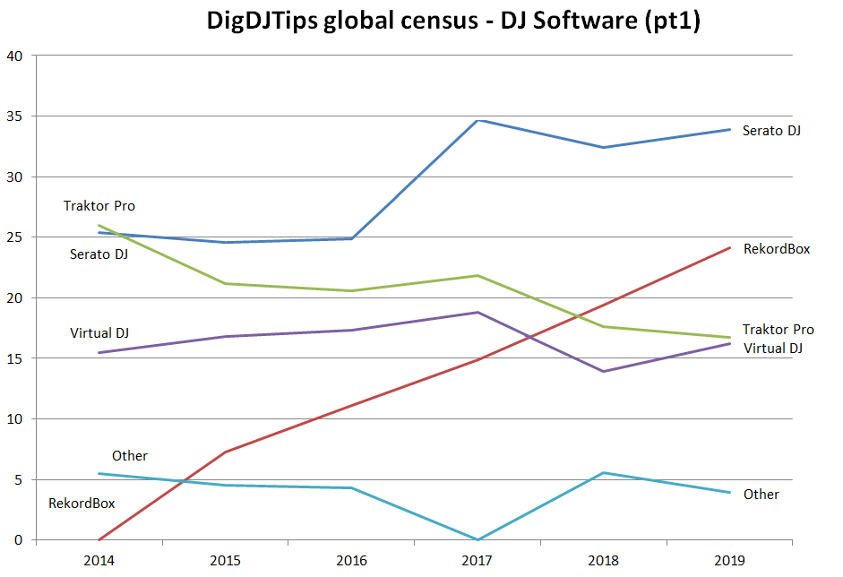
DigitalDJTips - DJ software #1

Slide 2
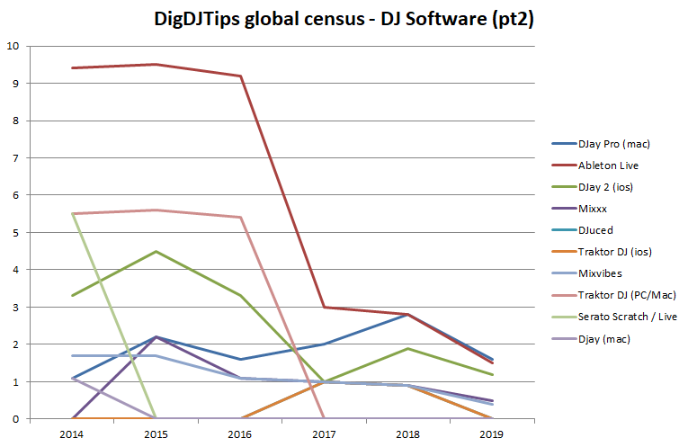
DigitalDJTips - DJ software #2

Slide 3
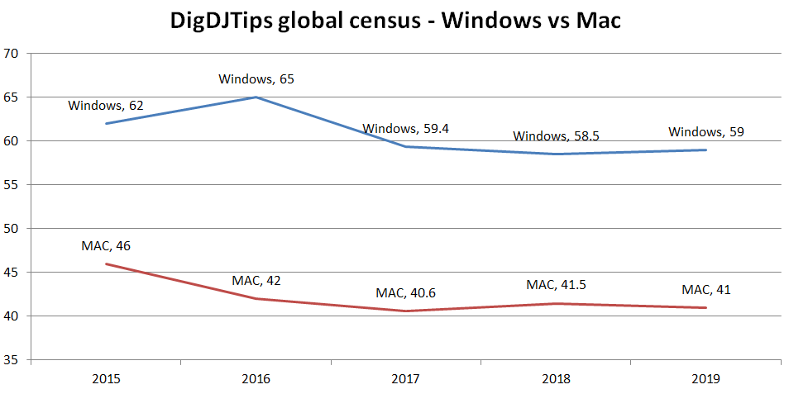
DigitalDJTips - Platform

Slide 4
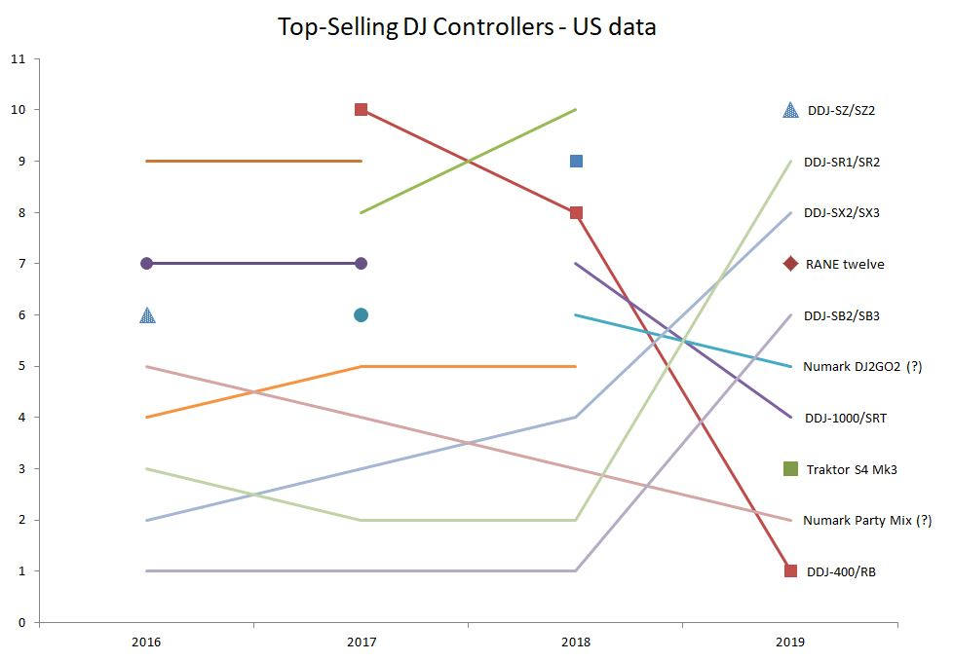
DJTechTools - Top #10 selling controllers

Slide 5
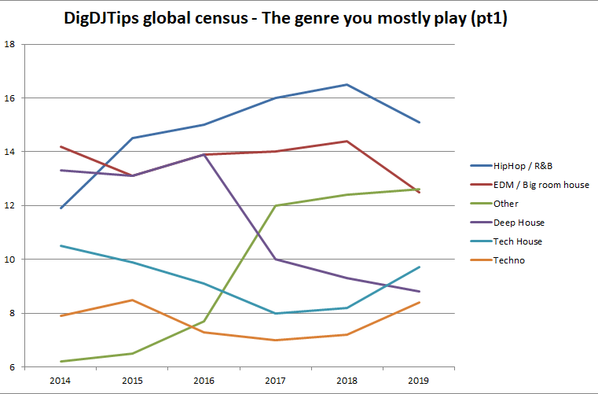
Digital DJ Tips – Most popular genres

Slide 6
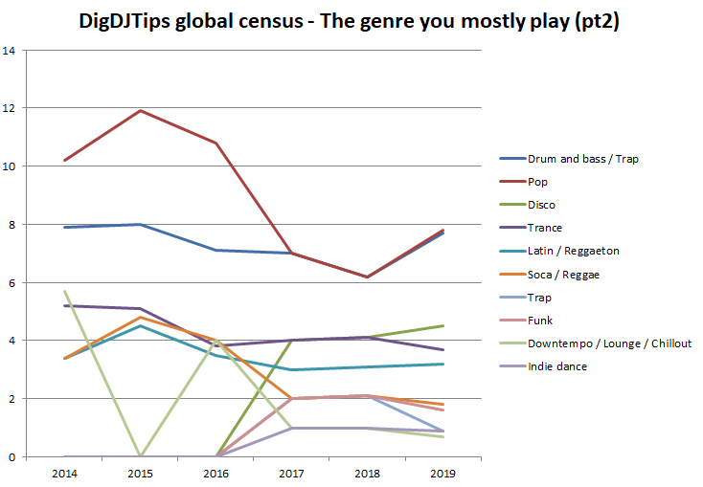
Digital DJ Tips – Most popular genres

